Slide 1



Risk
Management
FOR A SMALL BUSINESS
Updated: 09-2016

Slide 2

Welcome
Agenda
Ground Rules
Introductions

Slide 3
Objectives
Identify the common risks associated with a small business
Identify the external and internal factors which affect risk for a small business
Identify situations which may cause risk for a small business

Slide 4
Objectives
Indentify the common warning signs of risk for a small business
Implement, monitor, and evaluate a risk management plan for a small business

Slide 5

What Do You Know?
What do you know or want to learn about risk management?

Slide 6

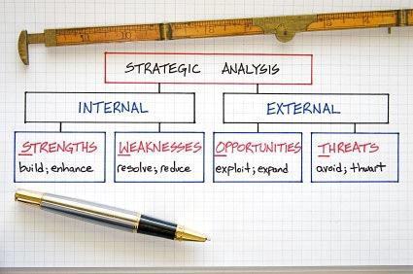
Risk Management
Identifying areas of threat to the business
Assessing the potential impacts and managing these
Growth and continued existence of the business

Slide 7

Discussion Point #1: Risks from Positive Situations
What positive situations or opportunities can you think of that may be risks?

Slide 8
Internal Risks

Slide 9


Human Risks
Death
  Owner
  Employee
Illness
  Short term
  Long term
  Indefinite

Slide 10

Human Risks
Theft and fraud
  Product and inventory theft
  Time sheet fraud
  Accounting and cash fraud
Low morale, dissatisfaction
  Failure to perform
  Sabotage of systems, equipment or customers

Slide 11

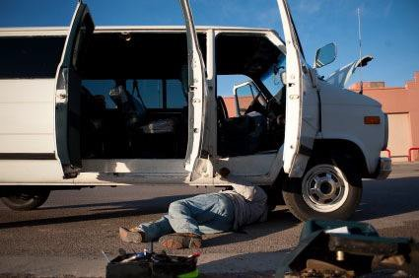
Equipment and Information Technology Risks
Equipment breakdowns
  New equipment integration
  Worn older equipment
  Damage to vehicles

Slide 12

Equipment and Information Technology Risks
Information technology downtime
  Lack of backup or recovery system
  Updates and repairs
  Power and connectivity (physical damage and outdated systems)
  Lack of administrative controls

Slide 13


Other Internal Risks
Physical plant repairs
  Breaks in lines or utilities
  Routine maintenance
Incidents
  Work related injuries
  Damage to others’ property by employees
  Damage to your property by others

Slide 14

Other Internal Risks
Cash flow changes
  Unexpected costs
  Loss of credit lines
  Expenses to establish lines of credit

Slide 15
Activity 2: Internal Risks
What other internal risks can a business owner control?

Slide 16
External Risks

Slide 17
Competition and Market Risks
Loss of clients or customers
Loss of employees
Decrease in sales prices/fluctuating markets
Increases in vendor costs
Oil or gasoline price increases
Fixed cost changes (e.g., rent)

Slide 18


Business Environment Risks
Laws
Weather
Natural Disaster
Community

Slide 19
Discussion Point #3: External Risks
You own a steak house. A tainted meat scare in your area changes demand. How do you manage this risk or control
its effects?

Slide 20
Personal Conflict Risks
Family obligations, illnesses or deaths
Events of disaster that affect the home
Community involvement
Complacency

Slide 21
Discussion Point #4: Risks to Continued Operations
What is required for your business to continue operations?

Slide 22

Risk Identification
Written business plan
Outside sources to assist in identifying
Risks of your vendors or supplier
Business continuity assessment

Slide 23
Warning Signs
Excessive debt in relation to owners equity (total liabilities / owner’s equity)
Reliance on a small number of customers
Reliance on one product
Reliance on one or a small number of vendors

Slide 24
Warning Signs
Cash flow problems
Irregularities in accounting, bank or timecard records
Irregularities in computer system administrative reports
High employee turnover rate

Slide 25
Risk Evaluation
Identify needs for business continuity
Identify needs for potential or planned growth
Discuss risks with managers
Communicate risks to managers

Slide 26

SWOT Analysis
Strengths
Weaknesses
Opportunities
Threats

Slide 27

Other Resources
Bank or Commercial Lender
Small Business
Administration
Audit Firm or
CPA
Risk Insurance Provider
Internet Source

Slide 28
Risk Measurement
Effect on potential earnings and cash flow
Impact on the business for future growth
Costs related to the risk, should it occur
What would change in your business as a result
Weighing costs versus the benefits of the control

Slide 29



Importance of Risk Management
Cash Flow
Stability
Credit
Longevity

Slide 30
Risk Control Management and Implementation

Slide 31
Equipment and Vendors
Inclusion in initial written business plan
Readdress, monitor and update business plan periodically
Insure equipment and use service plans
Know your vendors and suppliers – backup relationships

Slide 32
Business Continuity
Location to continue business operations
Establish a manual system
Train staff to continue operations
Backup operating systems, list staff duties and contacts
Review contracts with vendors for provisions
Know systems provider backup and contingency operational plans

Slide 33
Information Technology Systems
Do not share login information
Protect systems with firewalls
Institute levels of access
Perform other reports
Sample transactions or use trial transactions
Conduct scheduled and surprise audits

Slide 34

Competition
Shop them
Check advertising
Product lines
Pricing
Customer interaction
Employee retention

Slide 35
Activity 5: Assets
What is your most liquid asset? How can you protect it?

Slide 36
Accounting and Cash Control
Separation of duties
Dual control of cash
Levels of authority observed
Periodic audits
Surprise audits
Insured deposits – FDIC
Plan for reserves in the budget

Slide 37
Employee Management
Pre-employment screening and background checks
Job descriptions and duties
Communicate clear expectations
Cross train staff
Identify temp agencies that specialize in
your field
Periodic evaluations and feedback

Slide 38
Employee Management
Manage by being present or walking around
Audit for payroll or time fraud
Benefits and compensation for retention
Incentives to avoid injuries and damages

Slide 39
Business Work Strategy
How can you manage your own risks?
Set work hours
Plan work with a balance
Set realistic goals
Train support staff or an assistant
Include in disability or death in business plan
Support system
Anticipate family and home needs

Slide 40
More on Control Management
Communication within organization
Routine assessment of physical plant
Be alert to changes in the community and laws
Awareness of news in the economy
Utilize lines of credit only when needed
Insure against damages from weather and disasters
Backup utilities – phones and generators

Slide 41

Lead by Example
Ethical and honest behavior will begin with management

Slide 42
Exit Strategy
Include exit strategy in business plan
Revisit it periodically
Insurance payment and liquidation of assets
Liquidation of assets without insurance
Trustee to handle
Family member
Employees

Slide 43

Plan and manage risks to succeed!

Slide 44
Eight Key Points to Remember
There are internal and external risks associated with a small business
Begin assessing the risks by completing a list of those events or resources involved with the business that could impact continued operations and cash flow
The costs to insure or minimize risks should be weighed to the potential impact involved
A business continuity plan should be part of your overall business plan

Slide 45
Eight Key Points to Remember
Strategies to avoid risks can include: communication, setting expectations, support systems, training staff, insurance, assessment and contingency planning
Be honest in reviewing your business for risk and warning signs
Seek assistance from others
An exit strategy is important

Slide 46

Summary
What final questions do you have?
What have you learned?
How would you evaluate the training?

Slide 47
Conclusion
You learned about:
Internal and external risks of a small business
How to identify and reduce the negative effects these can have on your business
Warning signs of risk
The steps in risk management planning
The importance of containing these risks
The need for an exit strategy

